Slide 1

Internet Banking
Bank in Your hands

Slide 2
Presented By:
Batch-98
Shesha Thallu - 6619
Bharathi Koliwad - 6605
Ganesh Renikunta - 6618
Adinarayana Kuruva - 6617
Raju Bhashabathini - 6611

Slide 3
CONTENTS:
Introduction
Problem statement
System Design
Technology
Results
Future Enhancements

Slide 4
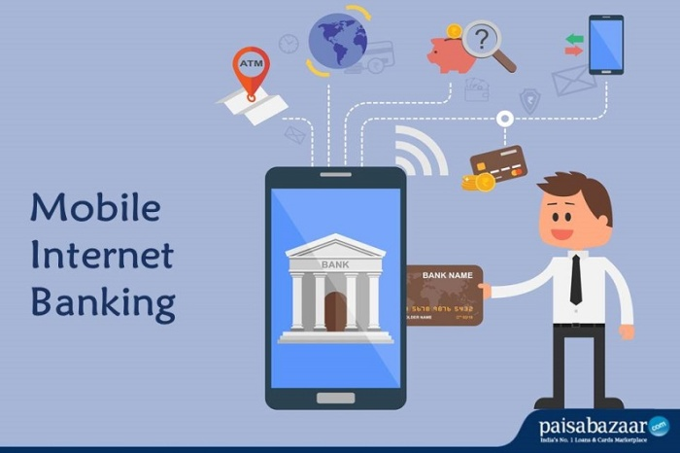
INTRODUCTION
Internet banking, also known as online banking is a facility offered by banks that allow customers to use banking services over the internet.
Customers need not visit their bank’s branch office to avail each and every small service.
Not all account holders get access to internet banking. If you would like to use internet banking services, you must register for the facility while opening the account or later.
You have to use the registered
username and password to log
into your internet banking account.

Slide 5
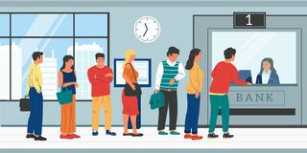
PROBLEM STATEMENT
In rapid growing world an individual cannot waste his/her time waiting in long queue.
During this pandemic it is not advised to form long queue or crowd formation.
The number of counters in a Bank and Number of Banks in Rural areas are less.
Employees and Senior Citizen can’t wait in Long Queue
Banks does not work 24/7 and remains closed on Public Holidays.

Slide 6
SYSTEM DESIGN
Browser
Controller layer
Service layer
Repository/ DOA layer
Database
User
No
Valid user
Login
Valid Details
Yes
Yes
Register
Dashboard
Logout
Deposit
Withdraw
Fund Transfer
Bank Statement
Profile

Slide 7




Technologies
CSS 3
Spring Boot MVC
HTML 5
Bootstrap
MYSQL

Slide 8
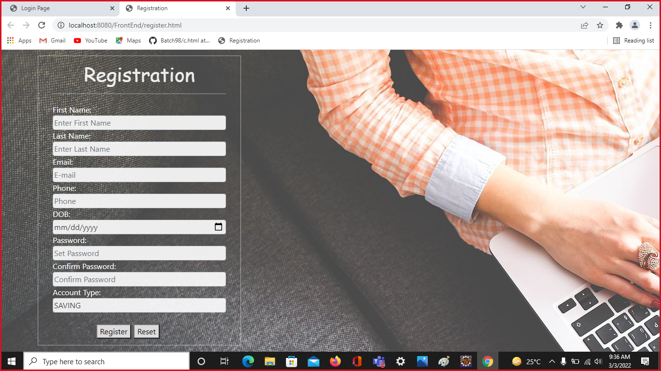
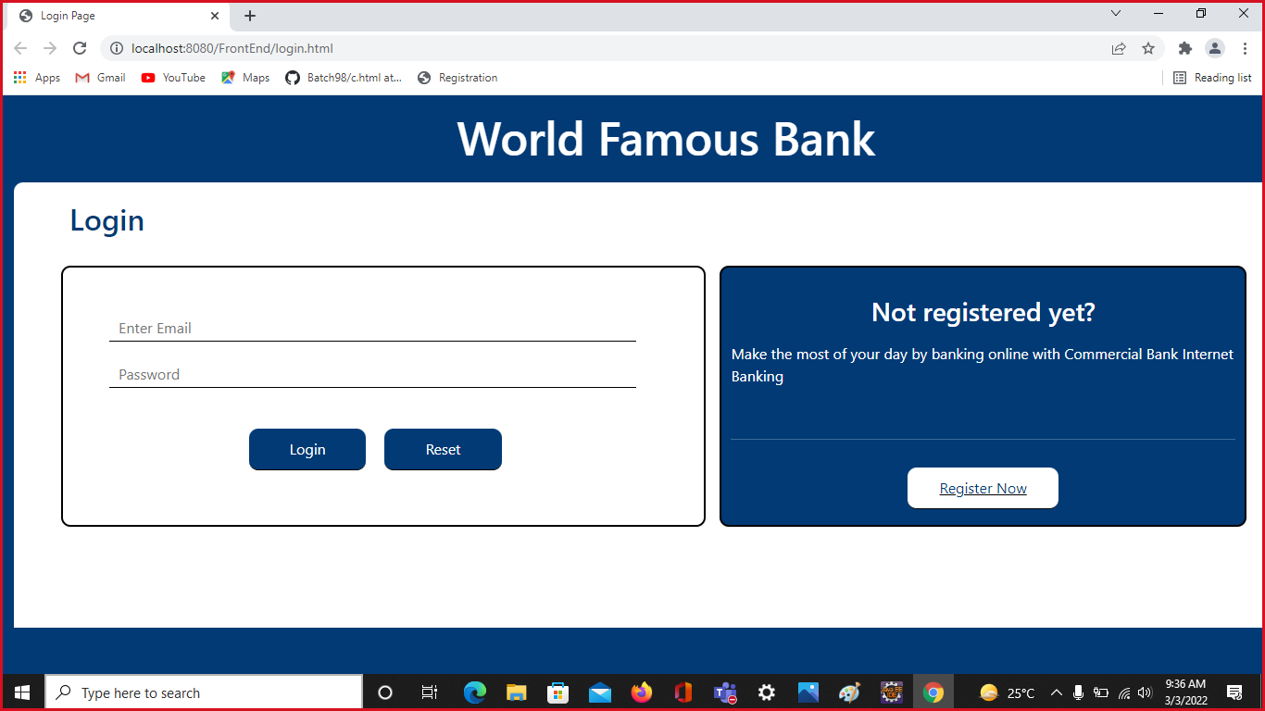

Slide 9
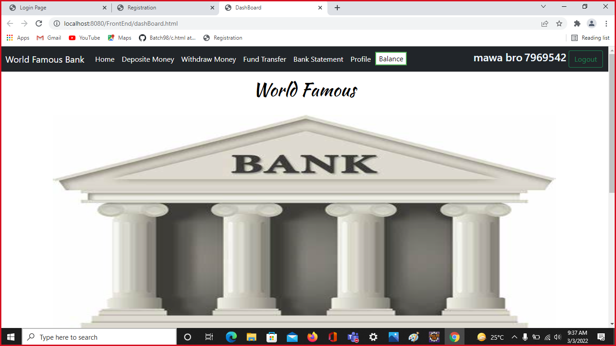
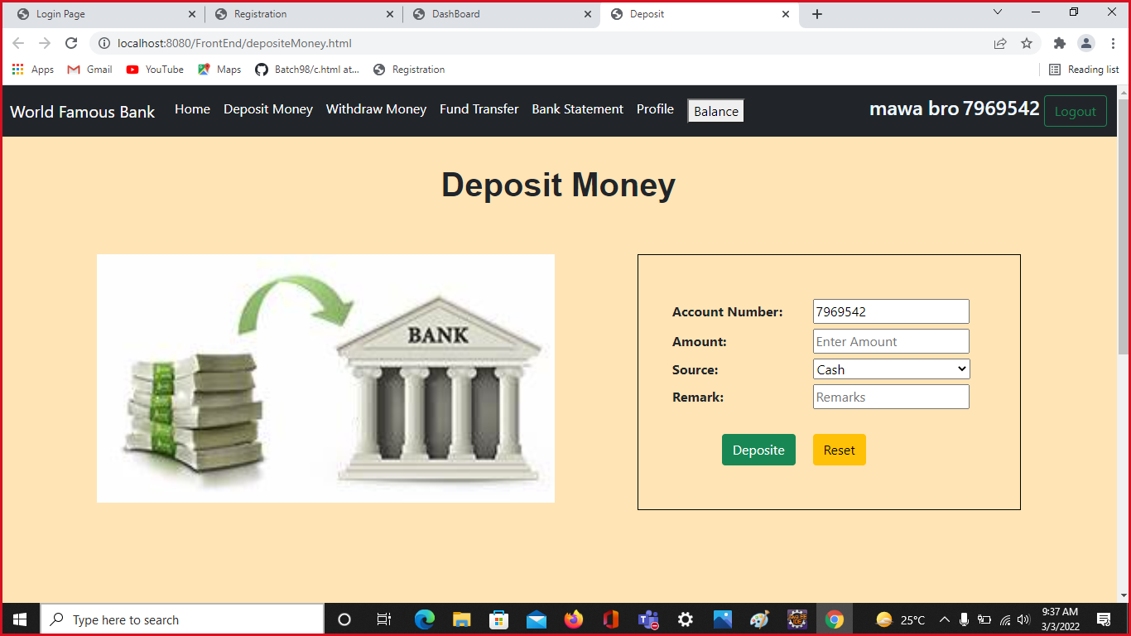

Slide 10
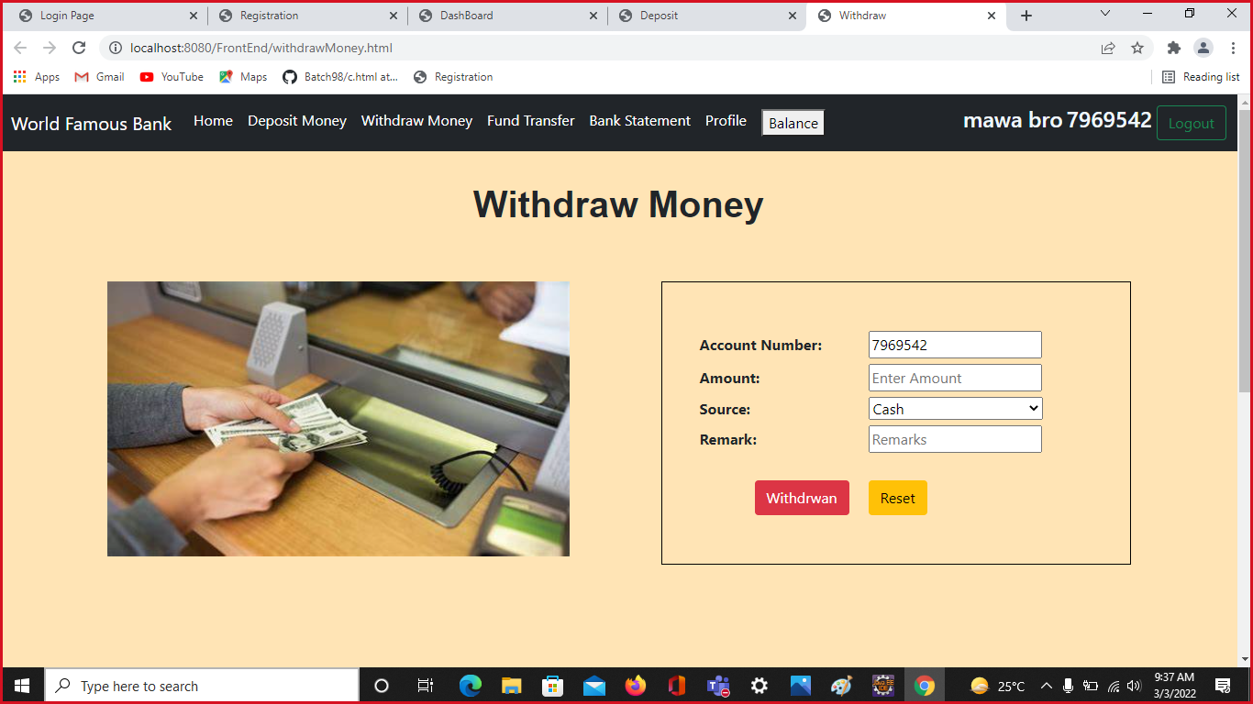
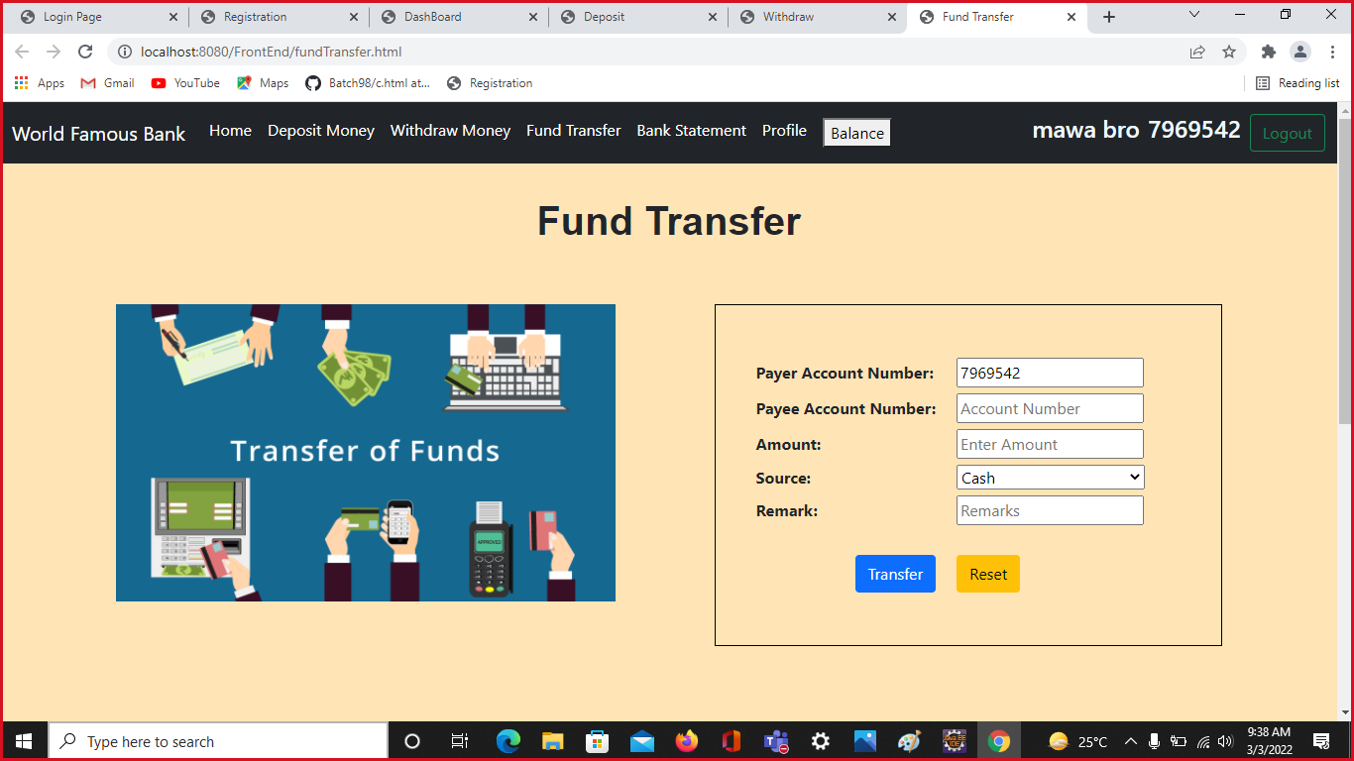

Slide 11
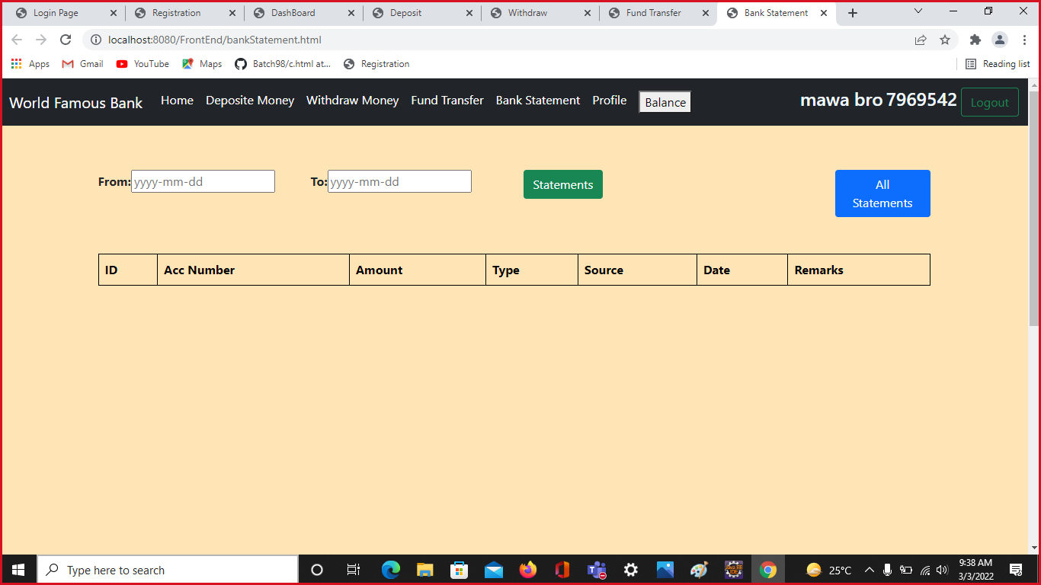
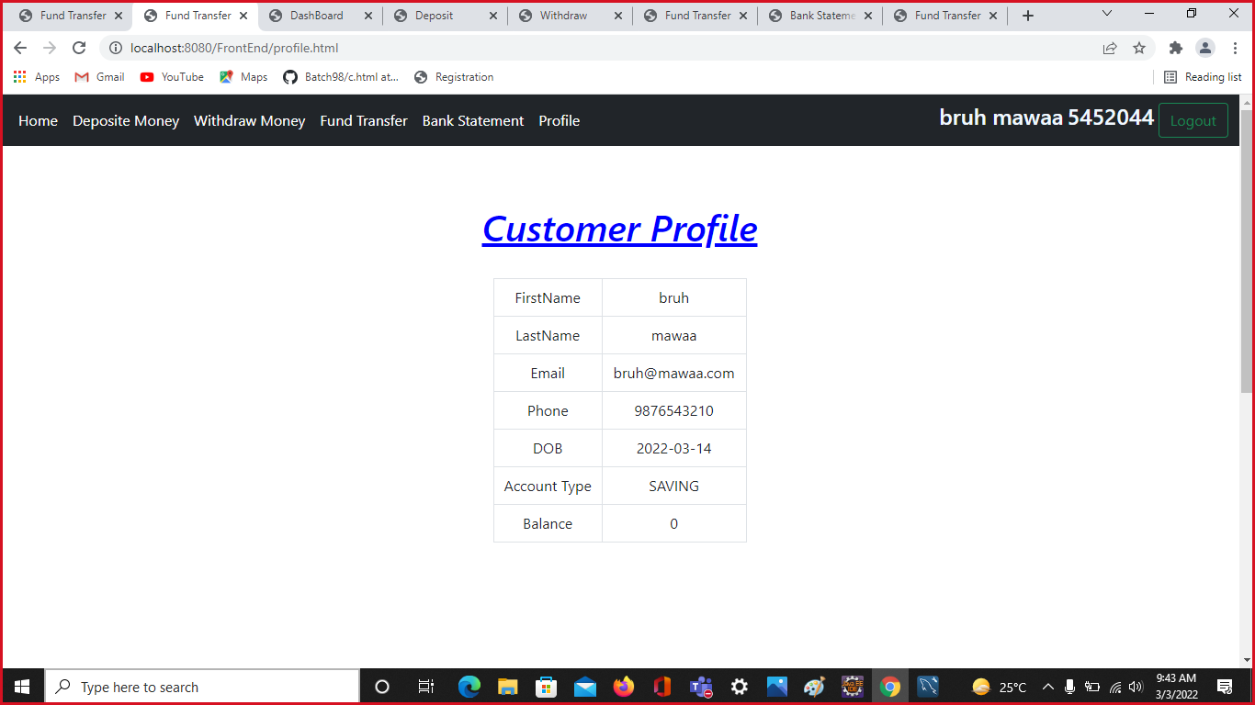

Slide 12

FUTURE ENHANCEMENT
The Advanced software of Internet Banking can be provided including more facilities like online bill payments, mobile recharge, gas booking etc.,
Two-Factor authentication includes OTP for improved security .
Account closure and Adding Nominee Details.

Slide 13

Any Queries??

Slide 14
Thank You

